Slide 1

Antiderivatives
Section 4.8

Slide 2
Antiderivatives
A physicist who knows the velocity of a particle might wish to know its position at a given time.
An engineer who can measure the variable rate at which water is leaking from a tank wants to know the amount leaked over a certain time period.
A biologist who knows the rate at which a bacteria population is increasing might want to deduce what the size of the population will be at some future time.

Slide 3
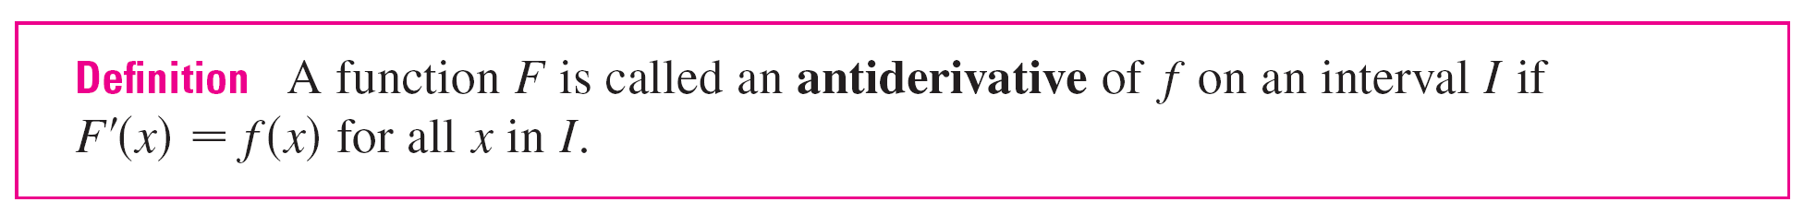
Antiderivatives
In each case, the problem is to find a function F whose derivative is a known function f. If such a function F exists, it is called an antiderivative of f.

Slide 4

Antiderivatives
For instance, let f (x) = x². It isn’t difficult to discover an antiderivative of f if we keep the Power Rule in mind. In fact, if F (x) = x³, then F ′(x) = x² = f (x).
But the function G(x) = x³ + 100 also satisfies G ′ (x) = x².
Therefore both F and G are antiderivatives of f.
Indeed, any function of the form H(x) = x³ + C, where C is
a constant, is an antiderivative of f.

Slide 5
Antiderivatives
Going back to the function f (x) = x², we see that the general antiderivative of f is x³/3 + C.

Slide 6
Antiderivatives
By assigning specific values to the constant C, we obtain a family of functions whose graphs are vertical translates of one another (see Figure 1).
This makes sense because each curve must have the same slope at any given value of x.
Members of the family of antiderivatives of f (x) = x²
Figure 1

Slide 7
Example 1
Find the most general antiderivative of each of the following functions.
(a) f (x) = sin x (b) f (x) = x^{n}, n ≥ 0 (c) f (x) = x^{–3}
Solution:
(a) If F (x) = –cos x, then F ′(x) = sin x, so an antiderivative of sin x is –cos x. By Theorem 1, the most general antiderivative is G(x) = –cos x + C.

Slide 8
Example 1 – Solution
cont’d
(b) We use the Power Rule to discover an antiderivative of x^{n}:
Thus the general antiderivative of f (x) = x^{n} is
This is valid for n ≥ 0 because f (x) = x^{n} then is defined on an interval.

Slide 9
Example 1 – Solution
cont’d
(c) If we put n = –3 in part (b) we get the particular antiderivative F (x) = x^{–2}/(–2) by the same calculation. But notice that f (x) = x^{–3} is not defined at x = 0.
Thus Theorem 1 tells us only that the general antiderivative of f is on any interval that does not contain 0. So the general antiderivative of is f (x) = 1/x³ is

Slide 10

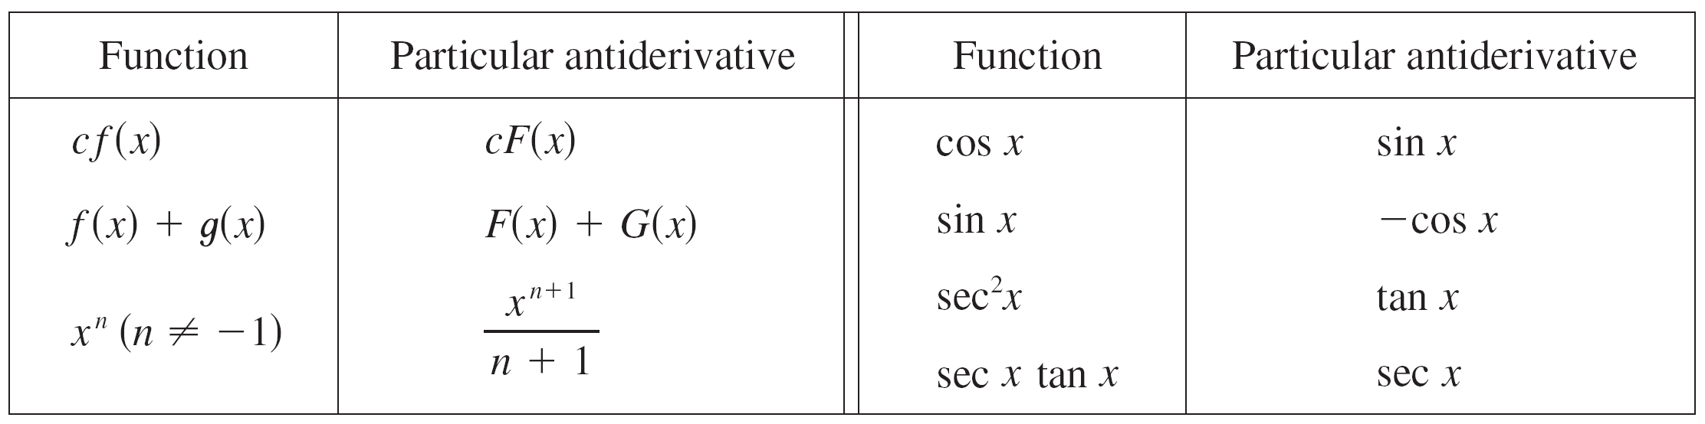
Antiderivatives
As in Example 1, every differentiation formula, when read from right to left, gives rise to an antidifferentiation formula. In Table 2 we list some particular antiderivatives.
To obtain the most general antiderivative from the particular ones in Table 2, we have to add a constant (or constants), as in Example 1.

Slide 11
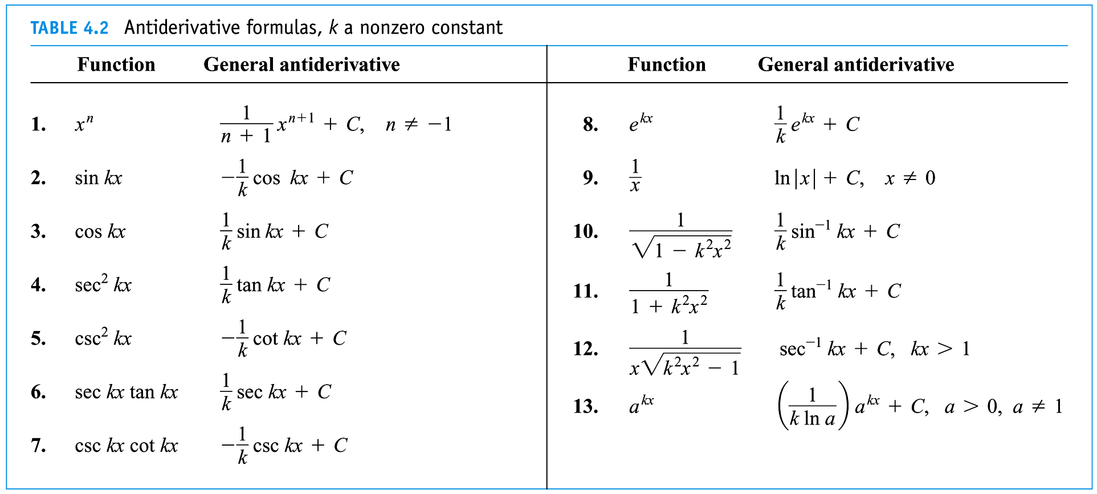
Antiderivative Formulas

Slide 12
